Slide 1

Building Modern Mobile Apps
Swift
Kevin Ford
Mobile Practice Lead
Magenic
Level: Intermediate

Slide 2
Kevin Ford
kevinf@magenic.com
@Bowman74
http://windingroadway.blogspot.com/
https://github.com/Bowman74

Slide 3
Mobile Tasks Source Code
GitHub
https://github.com/brentedwards/MobileTasks

Slide 4
What is Swift Development?
Syntax Improvements (no pointers!)
Object Oriented
Safety Checking
Interoperable with Objective-C

Slide 5
History and Background
Created by Apple
Language Specification Open Source
1.0 Version by Sep 9, 2014
Has not replaced Objetive-C
XCode IDE
Development done on a Mac

Slide 6
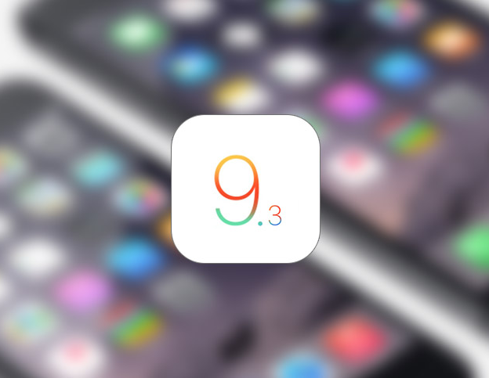
iOS 9.3
Released March 21, 2016
iOS 9.3 is the biggest incremental iPhone and iPad update in several years
Some key issues – removal from App Store
Apple released iOS 9.3.1 on March 31 to address device issues

Slide 7
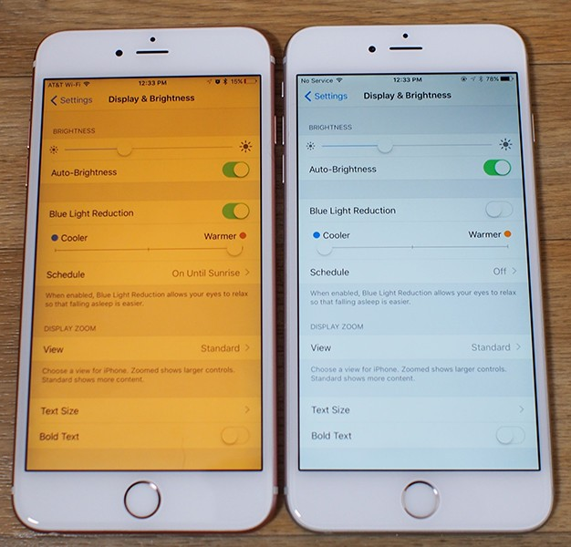
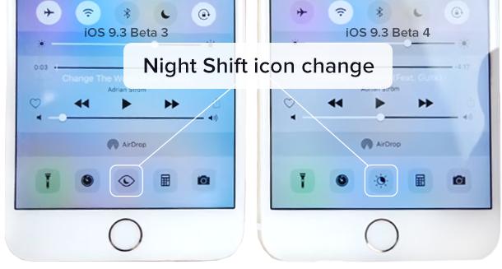
iOS 9.3 Major features
Night Shift
Limited Multi User Support
Updates to Apple Health
Care Kit

Slide 8
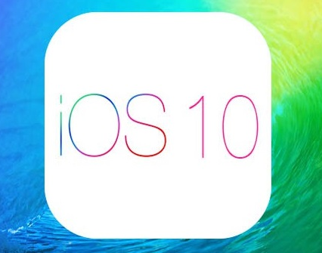

iOS 10
Apple is testing iOS 10 right now
release at Apple’s Worldwide Developers Conference event, June 8-12
iOS 10 should launch alongside the new iPhone7 in September, 2016

Slide 9
iOS API - A World of “Kits”

Slide 10
The Development Environment

Slide 11
Demo: Looking at the toolset

Slide 12
UIApplicationDelegate

Slide 13
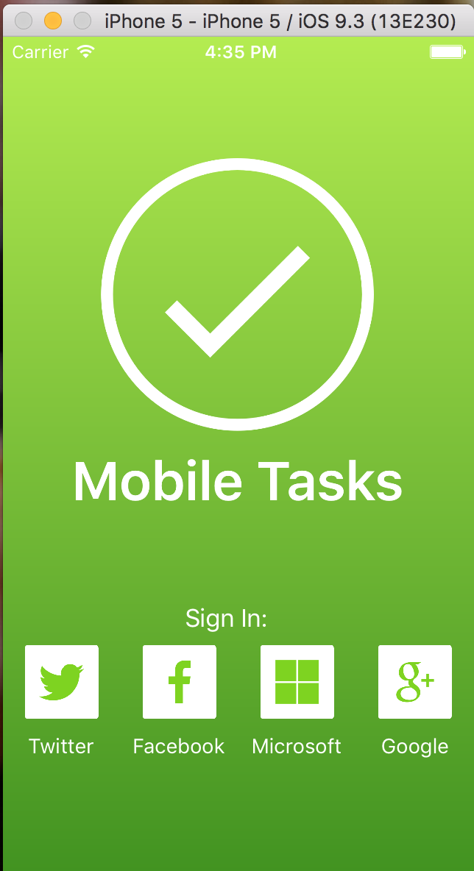
Model View Controller
UIViewController
MVC Pattern
Outlets
Controller – View coupling
UITableViewController
Model
Make a base view controller

Slide 14
Lifecycle

Slide 15
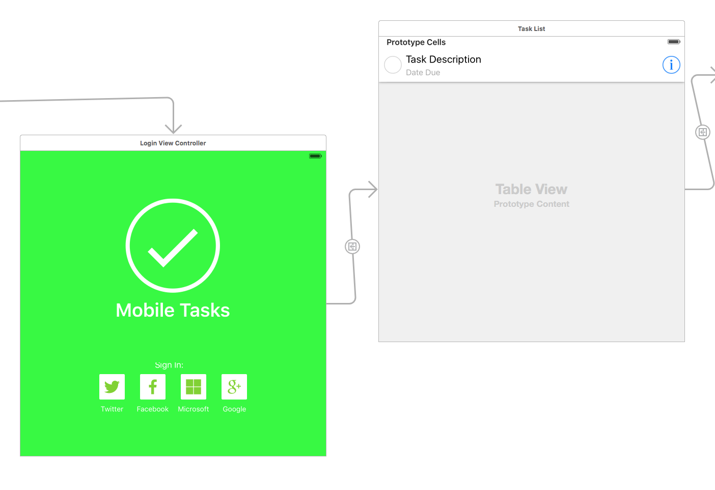
The Story Board
Primary Designer
Backed by XML
Views , Segues and Outlets
Absolute Positioning
Xib Files

Slide 16
Auto layout and Constraints
Auto layout describes relationships between views, it doesn’t layout automatically
Constraints normally work with:
Width, Height, Centering, Space between edges
Should consider horizontal and vertical orientations
Constraints can be done in the designer, in code or via the Visual Format language
Constraints can be handled in code but…

Slide 17
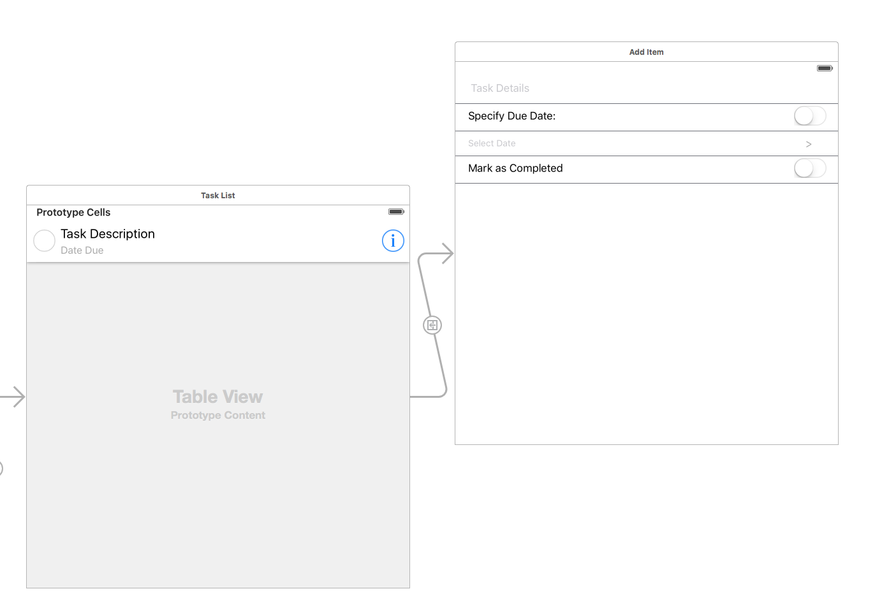
Segues

Slide 18
Outlets
Allow controller to access views
No access by default
IBOutlet
Love the control key

Slide 19
Demo: Looking at the Storyboard

Slide 20
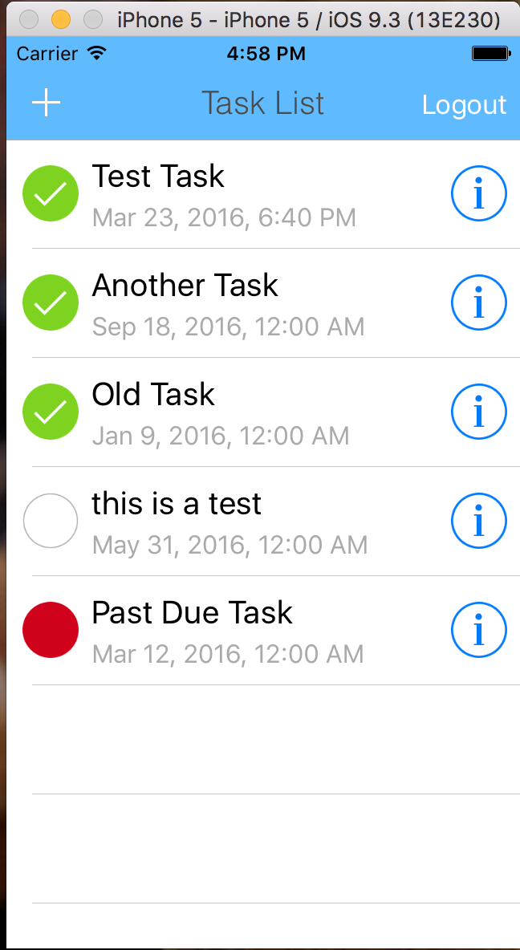
UITableView
Only loads what is needed
Collection of custom rows - UITableViewCell
Managed by UITableViewController
Parts of a table view
Section header, cells, section footer, index
Auto-sizing rows (iOS 8)

Slide 21
UIStackView
Controls layout of children
Horizontal or vertical
Minimum version of iOS 9

Slide 22
Common Controls
Button
Date Picker
Page
Text
Slider
Switch

Slide 23
Protocols
Similar to C# Interface
“Interface” means something else in C
Adaptive Through Resources
protocol TaskProtocol {
func didSaveItem(task : MobileTask)
}

Slide 24
Phones vs. Tablets
Can be a single binary
Can be either phone or tablet
Known as universal apps

Slide 25
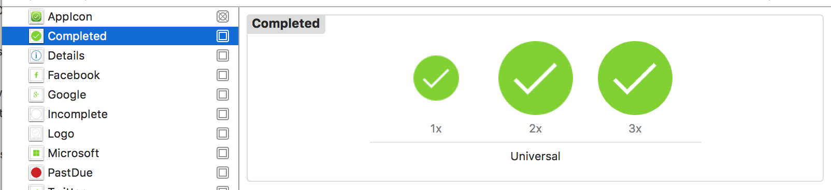
Image Assets
XCAssets file
Some icons required – platform dependent
Image sizes based on file naming convention
Which icon used depends on device type

Slide 26
Application Wide Styling
UIAppearance
Most controls have Appearance() method
Works on all controls of type
UISwitch.appearance().onTintColor = someUIColor

Slide 27
Connecting to Azure
Linked Framework
MicrosoftAzureMobile.framework
Async done via typealias
Json handling via NSDictionary

Slide 28
Azure Authentication
func login(serviceProvider: String, controller: UIViewController, completion: ServiceResponse) {
NetworkService.mobileClient?.loginWithProvider(serviceProvider, controller: controller, animated: false, completion: { (user : MSUser?, error : NSError?) -> Void in
if (user != nil) {
let currentToken : String = (user?.mobileServiceAuthenticationToken!)!
let currentUserId : String = (user?.userId)!
NSUserDefaults.standardUserDefaults().setObject(serviceProvider, forKey: LastUsedProvider)
NSUserDefaults.standardUserDefaults().setObject(currentUserId, forKey: serviceProvider + UserId)
NSUserDefaults.standardUserDefaults().setObject(currentToken, forKey: serviceProvider + Token)
completion(nil)
return
}
completion(error)
return
})
}

Slide 29
Demo: The My Task App

Slide 30
Conclusion
Excellent choice for iOS only environment
Creates small and fast binaries
Fast compile and deploy times
No Cross Platform Sharing Opportunities
Access to latest iOS features
Development only works on OSX

Slide 31
Questions?

